Slide 1



Advanced Graph Algorithms
Spanning Trees, Shortest Paths
Advanced Graph Algorithms
SoftUni Team
Technical Trainers
Software University
http://softuni.bg

Slide 2
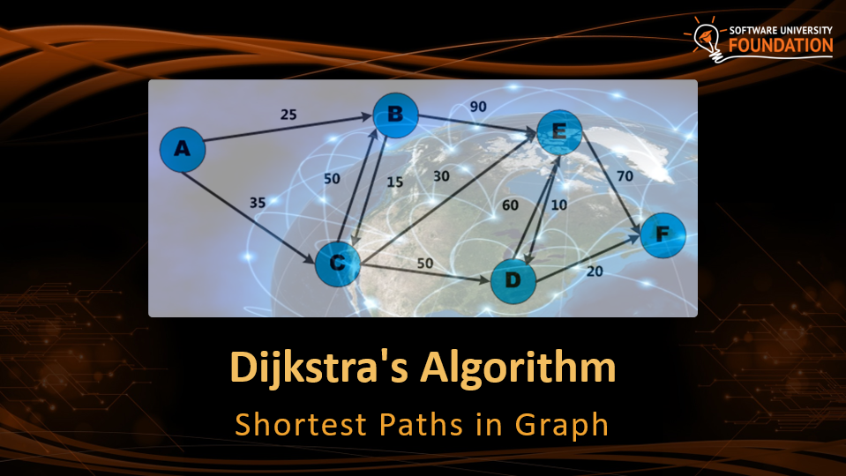
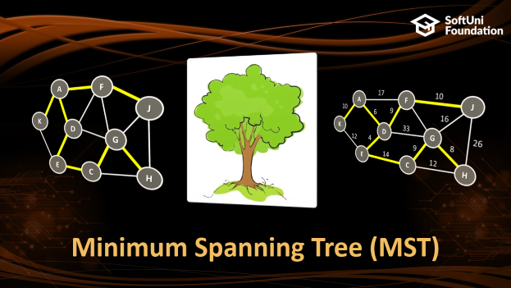
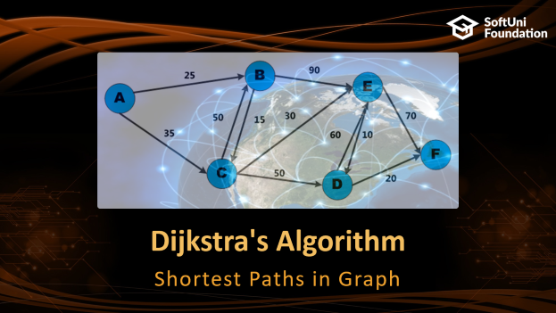
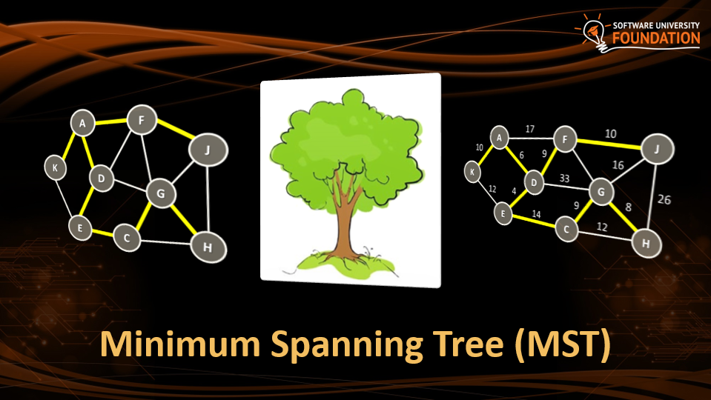
Table of Contents

Slide 3
Have a Question?
sli.do #DsAlgo

Slide 4

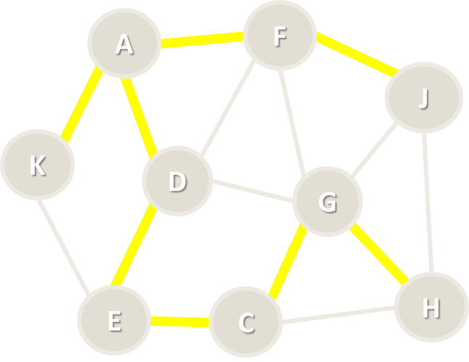
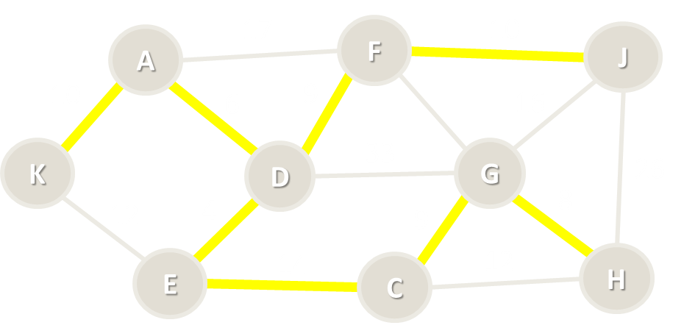
Minimum Spanning Tree (MST)

Slide 5
Spanning Tree
Spanning tree
Subgraph without cycles (tree)
Connects all vertices together
All connected graphs have a spanning tree
All undirected graphs have spanning forest
A
F
J
K
D
G
H
E
C

Slide 6

Minimum Spanning Tree (MST)
Minimum spanning tree (MST)
Weight <= weight(all other spanning trees)
First used in electrical networks
Minimal cost of wiring
17
F
14
A
J
10
6
13
11
16
K
D
33
G
26
12
4
9
20
E
14
22
H
C

Slide 7
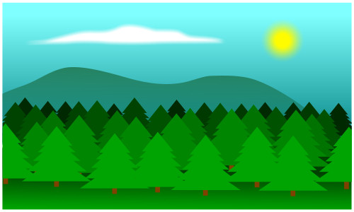
Minimum Spanning Forest (MSF)
Minimum spanning forest
Set of all minimum spanning trees (when the graph is not connected)
L
8
7
B
10
I
17
F
14
A
J
10
6
13
11
16
K
D
33
G
26
12
4
9
20
E
14
C
22
H

Slide 8
Kruskal's Algorithm
H
8
7
G
10
I
A
5
C
7
E
4
9
20
8
12
B
2
D
F

Slide 9
Kruskal's Algorithm
Create a forest F holding all graph vertices and no edges
Create a set S holding all edges in the graph
While S is non-empty
Remove the edge e with min weight from S
If e connects two different trees
Add e to the forest
Join these two trees into a single tree
The graph may not be connected
H
8
7
G
10
I
A
5
C
7
E
4
9
20
8
12
B
2
D
F

Slide 10
Kruskal's Algorithm – Step #1
Start from forest holding all vertices and no edges
S = all edges, ordered by weight
F = { }
S = {BD=2, AB=4, AC=5, CE=7, HI=7, DE=8, GH=8, AD=9, GI=10, EF=12, CD=20}
A
5
C
7
E
H
4
9
20
8
8
7
12
2
D
F
G
10
I
B

Slide 11
Kruskal's Algorithm – Step #2
Take the smallest edge BD = 2
The edge BD connects different trees → add it to the forest
F = {BD=2}
S = {AB=4, AC=5, CE=7, HI=7, DE=8, GH=8, AD=9, GI=10, EF=12, CD=20}
A
5
C
7
E
H
4
9
20
8
8
7
12
2
D
F
G
10
I
B

Slide 12
Kruskal's Algorithm – Step #3
Take the smallest edge AB = 4
The edge AB connects different trees → add it to the forest
F = {BD=2, AB=4}
S = {AC=5, CE=7, HI=7, DE=8, GH=8, AD=9, GI=10, EF=12, CD=20}
A
5
C
7
E
H
4
9
20
8
8
7
12
2
D
F
G
10
I
B

Slide 13
Kruskal's Algorithm – Step #4
Take the smallest edge AC = 5
The edge AC connects different trees → add it to the forest
F = {BD=2, AB=4, AC=5}
S = {CE=7, HI=7, DE=8, GH=8, AD=9, GI=10, EF=12, CD=20}
A
5
C
7
E
H
4
9
20
8
8
7
12
2
D
F
G
10
I
B

Slide 14
Kruskal's Algorithm – Step #5
Take the smallest edge CE = 7
The edge CE connects different trees → add it to the forest
F = {BD=2, AB=4, AC=5, CE=7}
S = {HI=7, DE=8, GH=8, AD=9, GI=10, EF=12, CD=20}
A
5
C
7
E
H
4
9
20
8
8
7
12
2
D
F
G
10
I
B

Slide 15
Kruskal's Algorithm – Step #6
Take the smallest edge HI = 7
The edge CE connects different trees → add it to the forest
F = {BD=2, AB=4, AC=5, CE=7, HI=7}
S = {DE=8, GH=8, AD=9, GI=10, EF=12, CD=20}
A
5
C
7
E
H
4
9
20
8
8
7
12
2
D
F
G
10
I
B

Slide 16
Kruskal's Algorithm – Step #7
Take the smallest edge DE = 8
The edge DE causes a cycle (connects the same tree) → skip it
F = {BD=2, AB=4, AC=5, CE=7, HI=7}
S = {GH=8, AD=9, GI=10, EF=12, CD=20}
A
5
C
7
E
H
4
9
20
8
8
7
12
2
D
F
G
10
I
B

Slide 17
Kruskal's Algorithm – Step #8
Take the smallest edge GH = 8
The edge GH connects different trees → add it to the forest
F = {BD=2, AB=4, AC=5, CE=7, HI=7, GH=7}
S = {AD=9, GI=10, EF=12, CD=20}
A
5
C
7
E
H
4
9
20
8
8
7
12
2
D
F
G
10
I
B

Slide 18
Kruskal's Algorithm – Step #9
Take the smallest edge AD = 9
The edge AD causes a cycle (connects the same tree) → skip it
F = {BD=2, AB=4, AC=5, CE=7, HI=7, GH=7}
S = {GI=10, EF=12, CD=20}
A
5
C
7
E
H
4
9
20
8
8
7
12
2
D
F
G
10
I
B

Slide 19
Kruskal's Algorithm – Step #10
Take the smallest edge GI = 10
The edge GI causes a cycle (connects the same tree) → skip it
F = {BD=2, AB=4, AC=5, CE=7, HI=7, GH=7}
S = {EF=12, CD=20}
A
5
C
7
E
H
4
9
20
8
8
7
12
2
D
F
G
10
I
B

Slide 20
Kruskal's Algorithm – Step #11
Take the smallest edge EF = 12
The edge EF connects different trees → add it to the forest
F = {BD=2, AB=4, AC=5, CE=7, HI=7, GH=7, EF=12}
S = {CD=20}
A
5
C
7
E
H
4
9
20
8
8
7
12
2
D
F
G
10
I
B

Slide 21
Kruskal's Algorithm – Step #12
Take the smallest edge CD = 20
The edge CD causes a cycle (connects the same tree) → skip it
F = {BD=2, AB=4, AC=5, CE=7, HI=7, GH=7, EF=12}
S = { } → stop the algorithm
A
5
C
7
E
H
4
9
20
8
8
7
12
2
D
F
G
10
I
B

Slide 22
Kruskal's Algorithm – Pseudo Code
foreach v ∈ graph edges
parent[v] = v
foreach edge {u, v} ordered by weight(u, v)
var rootU = FindRoot(u)
var rootV = FindRoot[v]
if rootU ≠ rootV
print edge {u, v}
parent[rootU] = rootV
FindRoot(node)
while (parent[node] ≠ node)
node = parent[node]
return node
Time complexity: O(|E| * log* |E|)
See http://visualgo.net/ufds.html

Slide 23
Disjoint Sets Optimization
FindRoot(node)
var root = node
while (parent[root] ≠ root)
root = parent[root]
// Optimize the path to root
// Attach each path node directly to the root
while (node != root)
var oldParent = parent[node]
parent[node] = root
node = oldParent
return root

Slide 24
Kruskal's Algorithm
A
5
C
7
E
H
4
9
20
8
8
7
12
2
D
F
G
10
I
B
Live Demo

Slide 25
Prim's Algorithm
H
8
7
G
10
I
A
5
C
7
E
4
9
20
8
12
B
2
D
F

Slide 26
Prim's Algorithm
Given a graph G(V, E) find the minimum spanning forest T(V', E')
Attach to the tree T the starting node
While smallest edge exists
Attach to T the smallest possible edge from G without creating a cycle in T
Use the smallest edge (u, v), such that u ∈ T and v ∉ T
Start the Prim's algorithm many times from all nodes from G still not in T
H
8
7
G
10
I
A
5
C
7
E
4
9
20
8
12
B
2
D
F

Slide 27
Prim's Algorithm – Step #1
Start from the initial node A
Enqueue all edges from A to other graph nodes: AB, AC, AD
Spanning tree = {A}
Priority queue = {AB = 4}, {AC = 5}, {AD = 9}
A
5
C
7
E
H
4
9
20
8
8
7
12
2
D
F
G
10
I
B

Slide 28
Prim's Algorithm – Step #2
Dequeue the shortest edge {AB = 4} and add it to the tree
Enqueue all edges from B to other graph nodes: BD
Spanning tree = {AB = 4}
Priority queue = {BD = 2}, {AC = 5}, {AD = 9}
A
5
C
7
E
H
4
9
20
8
8
7
12
2
D
F
G
10
I
B

Slide 29
Prim's Algorithm – Step #3
Dequeue the shortest edge {BD = 2} and add it to the tree
Enqueue all edges from D to other graph nodes: DC, DE
Spanning tree = {AB = 4}, {BD = 2}
Priority queue = {AC = 5}, {DE = 8}, {AD = 9}, {CD = 20}
A
5
C
7
E
H
4
9
20
8
8
7
12
2
D
F
G
10
I
B

Slide 30
Prim's Algorithm – Step #4
Dequeue the shortest edge {AC = 5} and add it to the tree
Enqueue all edges from C to other graph nodes: CE
Spanning tree = {AB = 4}, {BD = 2}, {AC = 5}
Priority queue = {CE = 7}, {DE = 8}, {AD = 9}, {CD = 20}
A
5
C
7
E
H
4
9
20
8
8
7
12
2
D
F
G
10
I
B

Slide 31
Prim's Algorithm – Step #5
Dequeue the shortest edge {CE = 7} and add it to the tree
Enqueue all edges from E to other graph nodes: EF
Spanning tree = {AB = 4}, {BD = 2}, {AC = 5}, {CE = 7}
Priority queue = {DE = 8}, {AD = 9}, {EF = 12}, {CD = 20}
A
5
C
7
E
H
4
9
20
8
8
7
12
2
D
F
G
10
I
B

Slide 32
Prim's Algorithm – Step #6
Dequeue the shortest edge {DE = 8}
It would create a loop in the spanning tree → skip it
Spanning tree = {AB = 4}, {BD = 2}, {AC = 5}, {CE = 7}
Priority queue = {AD = 9}, {EF = 12}, {CD = 20}
A
5
C
7
E
H
4
9
20
8
8
7
12
2
D
F
G
10
I
B

Slide 33
Prim's Algorithm – Step #7
Dequeue the shortest edge {AD = 9}
It would create a loop in the spanning tree → skip it
Spanning tree = {AB = 4}, {BD = 2}, {AC = 5}, {CE = 7}
Priority queue = {EF = 12}, {CD = 20}
A
5
C
7
E
H
4
9
20
8
8
7
12
2
D
F
G
10
I
B

Slide 34
Prim's Algorithm – Step #8
Dequeue the shortest edge {EF = 12} and add it to the tree
Enqueue all edges from F to other graph nodes: no such edges
Spanning tree = {AB = 4}, {BD = 2}, {AC = 5}, {CE = 7}, {EF = 12}
Priority queue = {CD = 20}
A
5
C
7
E
H
4
9
20
8
8
7
12
2
D
F
G
10
I
B

Slide 35
Prim's Algorithm – Step #9
Dequeue the shortest edge {CD = 20}
It would create a loop in the spanning tree → skip it
Spanning tree = {AB = 4}, {BD = 2}, {AC = 5}, {CE = 7}, {EF = 12}
Priority queue = { } → stop the algorithm
A
5
C
7
E
H
4
9
20
8
8
7
12
2
D
F
G
10
I
B

Slide 36
Prim's Algorithm – Step #10
Start from the initial node G
Enqueue all edges from G to other graph nodes: GH, GI
Spanning tree = {AB, BD, AC, CE, EF}, {G}
Priority queue = {GH = 8}, {GI = 10}
A
5
C
7
E
H
4
9
20
8
8
7
12
2
D
F
G
10
I
B

Slide 37
Prim's Algorithm – Step #11
Dequeue the shortest edge {GH = 8} and add it to the tree
Enqueue all edges from H to other graph nodes: HI
Spanning tree = {AB, BD, AC, CE, EF}, {GH = 8}
Priority queue = {HI = 7}, {GI = 10}
A
5
C
7
E
H
4
9
20
8
8
7
12
2
D
F
G
10
I
B

Slide 38
Prim's Algorithm – Step #12
Dequeue the shortest edge {HI = 7} and add it to the tree
Enqueue all edges from I to other graph nodes: no such edges
Spanning tree = {AB, BD, AC, CE, EF}, {GH = 8}, {HI = 7}
Priority queue = {GI = 10}
A
5
C
7
E
H
4
9
20
8
8
7
12
2
D
F
G
10
I
B

Slide 39
Prim's Algorithm – Step #13
Dequeue the shortest edge {GI = 7} and add it to the tree
It would create a loop in the spanning tree → skip it
Spanning tree = {AB, BD, AC, CE, EF}, {GH = 8}, {HI = 7}
Priority queue = { } → stop the algorithm
A
5
C
7
E
H
4
9
20
8
8
7
12
2
D
F
G
10
I
B

Slide 40
Prim's Algorithm (with Priority Queue)
var spanningTreeNodes = Ø
foreach (v ϵ graphVertices)
if (v ∉ spanningTreeNodes)
Prim(v)
Prim(startNode)
spanningTreeNodes ← startNode
var priorityQueue = Ø
priorityQueue ← childEdges(startNode)
while (priorityQueue is not empty)
smallestEdge = priorityQueue.ExtractMin()
if (smallestEdge connects tree node with non-tree node)
print smallestEdge
spanningTreeNodes ← smallestEdge.nonTreeNode
priorityQueue ← childEdges(smallestEdge.nonTreeNode)
Time complexity: O(|E| * log |E|)
1
8
7
4
10
7
0
5
8
7
6
4
9
20
8
12
2
3
2
5

Slide 41
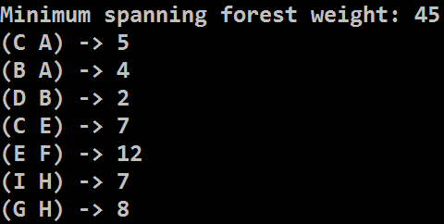
Prim's Algorithm with Priority Queue
H
8
7
G
10
I
A
5
C
7
E
4
9
20
8
12
B
2
D
F
Live Demo

Slide 42
Prim's Algorithm – Pseudo Code
var usedNodes = Ø;
for (v = 0…n-1)
if (not usedNodes[v])
Prim(v);
Prim(startNode)
usedNodes ← startNode
var edgeNode[0 … n-1]
var nearest[0 … n-1]
// Initially compute nearest[0…n-1]
for (i = 0 … n-1)
nearest[i] = weight[startNode → i]
or infinity when no edge exists {startNode → i}
edgeNode[i] = startNode
Time complexity: O(|V|²)
1
8
7
4
10
7
0
5
8
7
6
4
9
20
8
12
5
2
3
2

Slide 43
Prim's Algorithm – Pseudo Code (2)
while (true)
nearestNode = node i such that
i ∉ usedNodes and nearest[i] is the minimum possible
if (nearestNode does not exists) → return
usedNodes ← nearestNode
print edge { edgeNode[nearestNode] → nearestNode }
// Update nearest[] and edgeNode[] through nearestNode for each i ∉ [0 … n-1] and i ∉ usedNodes
if edge exists { nearestNode → i }
if weight[nearestNode → i] < nearest[i]
nearest[i] = weight[nearestNode → i]
edgeNode[i] = nearestNode;
end while

Slide 44
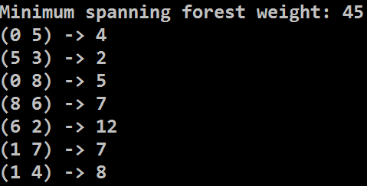
Prim's Algorithm with Adjacency Matrix
H
8
7
G
10
I
A
5
C
7
E
4
9
20
8
12
B
2
D
F
Live Demo

Slide 45
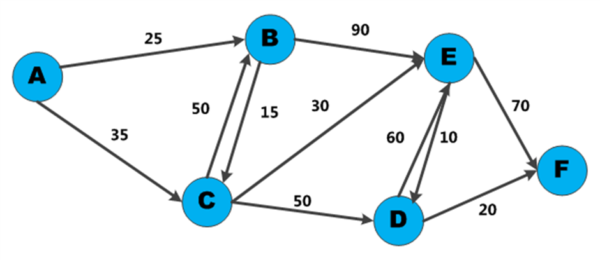

Dijkstra's Algorithm
Shortest Paths in Graph

Slide 46
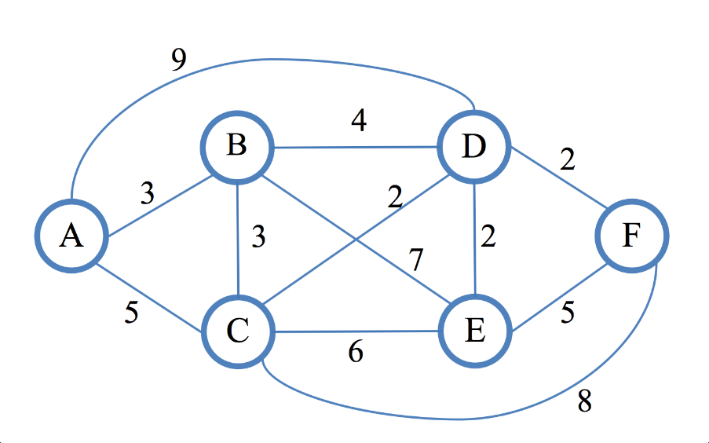
Dijkstra's Algorithm
Dijkstra's algorithm finds the shortest path from given vertex to all other vertices in a directed / undirected weighted graph
First described by Edsger W. Dijkstra in 1956
Assumptions
Weights on edges are non-negative
Edges can be directed or not
Weights do not have to be distances
Shortest path is not necessarily unique
Not all edges need to be reachable

Slide 47
Shortest Path in Unweighted Graph
In unweighted graphs finding the shortest path can be done with BFS (all edges have the same weight):
1
2
K
3
F
H
Start
E
1
2
3
I
A
J
4
D
2
2
B
4
G
C

Slide 48
Weighted Shortest Paths with BFS
In weighted graphs
Break the edges into sub-vertices and use BFS
* Too much memory usage even for smaller graphs!
A
A
5
3
B
2
C
B
C

Slide 49
Dijkstra's Algorithm
Dijskstra's algorithm is similar to BFS and to Prim's algorithms
Use a priority queue instead of queue
Keep the shortest distances so far
Steps in Dijkstra's algorithm:
v | A | B
d[v] | 30 | 15
v | A | B
d[v] | 25 | 15
Initially calculate all direct distances d[] from S
Enqueue that start node S
While (queue not empty)
Dequeue the nearest vertex B
Enqueue all unvisited child nodes of B
For each edge {B → A}, improve d[A] through B:
d[S → A] = min(d[S → A], d[S → B] + weight[B → A])
S
15
30
B
A
10

Slide 50
Dijkstra's Algorithm: Step #1
Initialize all distances d[] from s: d[0…n-1] = ∞; d[s] = 0
Enqueue the start node (0)
v | 0 | 1 | 2 | 3 | 4 | 5 | 6 | 7 | 8 | 9 | 10 | 11
d[v] | 0 | - | - | - | - | - | - | - | - | - | - | -
prev[v] | - | - | - | - | - | - | - | - | - | - | - | -
17
4
20
6
1
3
10
6
5
11
6
5
s
0
5
33
11
9
7
26
12
3
9
20
3
10
8
14
2
15
7

Slide 51
Dijkstra's Algorithm: Step #2
Dequeue the nearest vertex (0) and enqueue unvisited children: 6, 8
Improve min distances through child edges of 0: {0 → 6}, {0 → 8}
v | 0 | 1 | 2 | 3 | 4 | 5 | 6 | 7 | 8 | 9 | 10 | 11
d[v] | 0 | - | - | - | - | - | 10 | - | 12 | - | - | -
prev[v] | - | - | - | - | - | - | 0 | - | 0 | - | - | -
17
4
20
6
1
3
10
6
5
11
6
5
s
0
5
33
11
9
7
26
12
3
9
20
3
10
8
14
2
15
7

Slide 52
Dijkstra's Algorithm: Step #3
Dequeue the nearest vertex (6) and enqueue unvisited children: 4, 5
Improve min distances through child edges of 6: {6 → 4}, {6 → 5}
v | 0 | 1 | 2 | 3 | 4 | 5 | 6 | 7 | 8 | 9 | 10 | 11
d[v] | 0 | - | - | - | 27 | 16 | 10 | - | 12 | - | - | -
prev[v] | - | - | - | - | 6 | 6 | 0 | - | 0 | - | - | -
17
4
20
6
1
3
10
6
5
11
6
5
s
0
5
33
11
9
7
26
12
3
9
20
3
10
8
14
2
15
7

Slide 53
Dijkstra's Algorithm: Step #4
Dequeue the nearest vertex (8) and enqueue unvisited children: 2
Improve min distances through child edges of 8: {8 → 2}, {8 → 5}
v | 0 | 1 | 2 | 3 | 4 | 5 | 6 | 7 | 8 | 9 | 10 | 11
d[v] | 0 | - | 26 | - | 27 | 15 | 10 | - | 12 | - | - | -
prev[v] | - | - | 8 | - | 6 | 8 | 0 | - | 0 | - | - | -
17
4
20
6
1
3
10
6
5
11
6
5
s
0
5
33
11
9
7
26
12
3
9
20
3
10
8
14
2
15
7

Slide 54
Dijkstra's Algorithm: Step #5
Dequeue the nearest vertex (5) and enqueue unvisited children: 11
Improve min distances through child edges of 5: {5 → 4}, {5 → 11}
v | 0 | 1 | 2 | 3 | 4 | 5 | 6 | 7 | 8 | 9 | 10 | 11
d[v] | 0 | - | 26 | - | 20 | 15 | 10 | - | 12 | - | - | 48
prev[v] | - | - | 8 | - | 5 | 8 | 0 | - | 0 | - | - | 5
17
4
20
6
1
3
10
6
5
11
6
5
s
0
5
33
11
9
7
26
12
3
9
20
3
10
8
14
2
15
7

Slide 55
Dijkstra's Algorithm: Step #6
Dequeue the nearest vertex (4) and enqueue unvisited children: 1
Improve min distances through child edges of 4: {4 → 1}, {4 → 11}
v | 0 | 1 | 2 | 3 | 4 | 5 | 6 | 7 | 8 | 9 | 10 | 11
d[v] | 0 | 40 | 26 | - | 20 | 15 | 10 | - | 12 | - | - | 31
prev[v] | - | 4 | 8 | - | 5 | 8 | 0 | - | 0 | - | - | 4
17
4
20
6
1
3
10
6
5
11
6
5
s
0
5
33
11
9
7
26
12
3
9
20
3
10
8
14
2
15
7

Slide 56
Dijkstra's Algorithm: Step #7
Dequeue the nearest vertex (2) and enqueue unvisited children: 7
Improve min distances through child edges of 2: {2 → 7}, {2 → 11}
v | 0 | 1 | 2 | 3 | 4 | 5 | 6 | 7 | 8 | 9 | 10 | 11
d[v] | 0 | 40 | 26 | - | 20 | 15 | 10 | 41 | 12 | - | - | 31
prev[v] | - | 4 | 8 | - | 5 | 8 | 0 | 2 | 0 | - | - | 4
17
4
20
6
1
3
10
6
5
11
6
5
s
0
5
33
11
9
7
26
12
3
9
20
3
10
8
14
2
15
7

Slide 57
Dijkstra's Algorithm: Step #8
Dequeue the nearest vertex (11) and enqueue unvisited children: none
Improve min distances through child edges of 11: {11 → 1}, {11 → 7}
v | 0 | 1 | 2 | 3 | 4 | 5 | 6 | 7 | 8 | 9 | 10 | 11
d[v] | 0 | 37 | 26 | - | 20 | 15 | 10 | 41 | 12 | - | - | 31
prev[v] | - | 11 | 8 | - | 5 | 8 | 0 | 2 | 0 | - | - | 4
17
4
20
6
1
3
10
6
5
11
6
5
s
0
5
33
11
9
7
26
12
3
9
20
3
10
8
14
2
15
7

Slide 58
Dijkstra's Algorithm: Step #9
Dequeue the nearest vertex (1) and enqueue unvisited children: 9
Improve min distances through child edges of 1: {1 → 7}, {1 → 9}
v | 0 | 1 | 2 | 3 | 4 | 5 | 6 | 7 | 8 | 9 | 10 | 11
d[v] | 0 | 37 | 26 | - | 20 | 15 | 10 | 41 | 12 | 42 | - | 31
prev[v] | - | 11 | 8 | - | 5 | 8 | 0 | 2 | 0 | 1 | - | 4
17
4
20
6
1
3
10
6
5
11
6
5
s
0
5
33
11
9
7
26
12
3
9
20
3
10
8
14
2
15
7

Slide 59
Dijkstra's Algorithm: Step #10
Dequeue the nearest vertex (7) and enqueue unvisited children: none
Improve min distances through child edges of 7: {7 → 9}
v | 0 | 1 | 2 | 3 | 4 | 5 | 6 | 7 | 8 | 9 | 10 | 11
d[v] | 0 | 37 | 26 | - | 20 | 15 | 10 | 41 | 12 | 42 | - | 31
prev[v] | - | 11 | 8 | - | 5 | 8 | 0 | 2 | 0 | 1 | - | 4
17
4
20
6
1
3
10
6
5
11
6
5
s
0
5
33
11
9
7
26
12
3
9
20
3
10
8
14
2
15
7

Slide 60
Dijkstra's Algorithm: Step #11
Dequeue the nearest vertex (9) and enqueue unvisited children: none
Improve min distances through child edges of 9: none
v | 0 | 1 | 2 | 3 | 4 | 5 | 6 | 7 | 8 | 9 | 10 | 11
d[v] | 0 | 37 | 26 | - | 20 | 15 | 10 | 41 | 12 | 42 | - | 31
prev[v] | - | 11 | 8 | - | 5 | 8 | 0 | 2 | 0 | 1 | - | 4
17
4
20
6
1
3
10
6
5
11
6
5
s
0
5
33
11
9
7
26
12
3
9
20
3
10
8
14
2
15
7

Slide 61
Dijkstra's Algorithm: Step #12
The queue is empty → Dijkstra's algorithm is completed
d[v] hold shortest distances; prev[v] holds shortest paths tree edges
v | 0 | 1 | 2 | 3 | 4 | 5 | 6 | 7 | 8 | 9 | 10 | 11
d[v] | 0 | 37 | 26 | - | 20 | 15 | 10 | 41 | 12 | 42 | - | 31
prev[v] | - | 11 | 8 | - | 5 | 8 | 0 | 2 | 0 | 1 | - | 4
17
4
20
6
1
3
10
6
5
11
6
5
s
0
5
33
11
9
7
26
12
3
9
20
3
10
8
14
2
15
7

Slide 62
Dijkstra's Algorithm: Step #13
The output is the shortest paths tree from the starting node to all others
Reconstruct the path destination to source using prev[v]
v | 0 | 1 | 2 | 3 | 4 | 5 | 6 | 7 | 8 | 9 | 10 | 11
d[v] | 0 | 37 | 26 | - | 20 | 15 | 10 | 41 | 12 | 42 | - | 31
prev[v] | - | 11 | 8 | - | 5 | 8 | 0 | 2 | 0 | 1 | - | 4
prev[v] holds the shortest paths tree edges
Path[9 → 0] = {9 → 1 → 11 → 4 → 5 → 6 → 0}
4
6
1
10
5
11
6
5
0
5
11
9
12
3
8
14
15
7
2

Slide 63
Dijkstra's Algorithm – Pseudo Code
d[0…n-1] = INFINITY; d[startNode] = 0
Q = priority queue holding nodes ordered by distance d[]
startNode → Q
while (Q is not empty)
minNode = dequeue the smallest node from Q
if (d[minNode] == INFINITY) break;
foreach (child c of minNode)
if (c is unvisited) c → Q
newDistance = d[minNode] + distance {minNode → c}
if (newDistance < d[c])
d[c] = newDistance;
reorder Q;
}

Slide 64
Dijkstra's Algorithm – More Details
Modifications
Implementation with array, priority queue
Having a target node + stop when it is found
Saving the shortest paths tree (prev[v])
Complexity depends on the implementation
Typical implementation (with array): O(|V|²)
With priority queue: O((|V|+|E|)*log(|V|))
Applications – maps, GPS, networks, air travel, etc.

Slide 65
Dijkstra's Algorithm
17
4
20
6
1
3
10
6
5
11
6
5
s
0
5
33
11
9
7
26
12
3
9
20
3
10
8
14
2
15
7
Live Demo

Slide 66
Bellman-Ford
The Bellman-Ford algorithm finds the shortest paths from a single source to all other vertices
Unlike Dijkstra's algorithm, Bellman-Ford works with negative weight edges
Can detect negative cycles and report them
Runs in time O(|V||E|)
Uses dynamic programming

Slide 67
Floyd-Warshall
The Floyd-Warshall algorithm computes the shortest paths between all pairs of vertices
Edge weights can be positive or negative
Can be extended to detect negative weight cycles
Has running time of O(|V|³)
Performs better than running Bellman-Ford for each vertex
Also uses dynamic programming

Slide 68

Summary
Minimum spanning tree (MST)
Solved by Prim's and Kruskal's algorithms
Shortest paths in a graph:
Dijkstra's algorithm – finds shortest path from a single source
Does not work with negative weight edges
Bellman-Ford – finds shortest path from a single source
Works with negative weights and reports negative-weight cycles
Floyd Warshall – finds shortest paths between all vertice pairs

Slide 69







Advanced Graph Algorithms
https://softuni.bg/opencourses/algorithms

Slide 70
License
This course (slides, examples, labs, videos, homework, etc.) is licensed under the "Creative Commons Attribution-NonCommercial-ShareAlike 4.0 International" license
Attribution: this work may contain portions from
"Fundamentals of Computer Programming with C#" book by Svetlin Nakov & Co. under CC-BY-SA license
"Data Structures and Algorithms" course by Telerik Academy under CC-BY-NC-SA license

Slide 71





Trainings @ Software University (SoftUni)
Software University – High-Quality Education, Profession and Job for Software Developers
softuni.bg
Software University Foundation
http://softuni.foundation/
Software University @ Facebook
facebook.com/SoftwareUniversity
Software University Forums
forum.softuni.bg

